Slide 1
Lecture 5
Materials Science and Engineering
International University
National University – HCMC
Dr. Nguyen Dinh Uyen

Slide 2
Chapter 5
Diffusion in Solids
Dr. Uyen Nguyen

Slide 3
Chapter 5: Diffusion in Solids
ISSUES TO ADDRESS...
• How does diffusion occur?
• Why is it an important part of processing?
• How can the rate of diffusion be predicted for
some simple cases?
• How does diffusion depend on structure
and temperature?

Slide 4
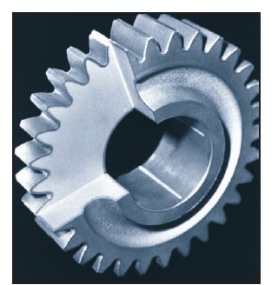
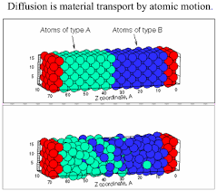
Harden the surface of the gear by high temperature heat treatment, this process diffuses the carbon into the surface of the steel to make it harder and stronger.

Slide 5
Diffusion
Diffusion - Mass transport by atomic motion
Mechanisms
Gases & Liquids – random (Brownian) motion
Solids – vacancy diffusion or interstitial diffusion
  There must be an empty adjacent site
  The atom must have sufficient energy to break bonds with its neighbor atoms and then cause some lattice distortion during the displacement
Notes:
Diffusion mechanism depends on material

Slide 6
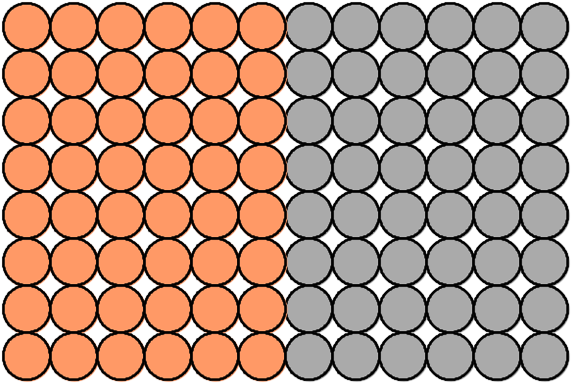
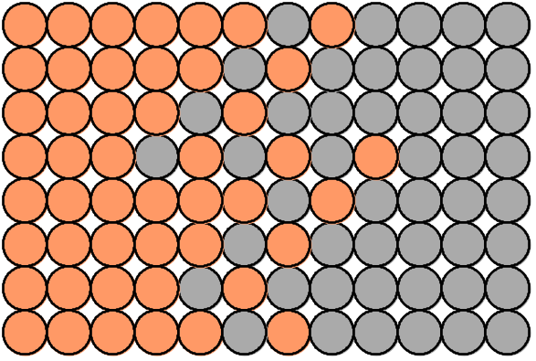
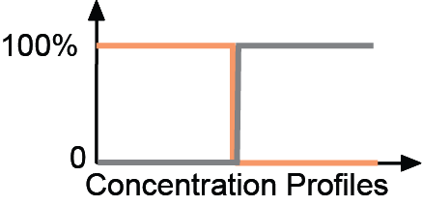
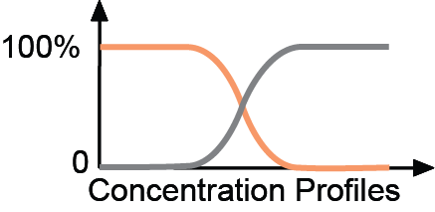
Diffusion
• Interdiffusion: In an alloy, atoms tend to migrate
from regions of high conc. to regions of low conc.
Initially
After some time
Adapted from Figs. 5.1 and 5.2, Callister 7e.

Slide 7
Self Diffusion
• Self-diffusion: In an elemental solid, atoms
also migrate.
Label some atoms
After some time
C
C
A
D
A
D
B
B
In fact, the atoms in solid materials are in constant motion, rapidly changing positions.

Slide 8
Diffusion Mechanisms
There are two types of Diffusion: Vacancy and Interstitial Diffusion
Vacancy Diffusion:
• atoms exchange with vacancies
• applies to substitutional impurities atoms
• rate depends on:
--number of vacancies
--activation energy to exchange.
increasing elapsed time

Slide 9
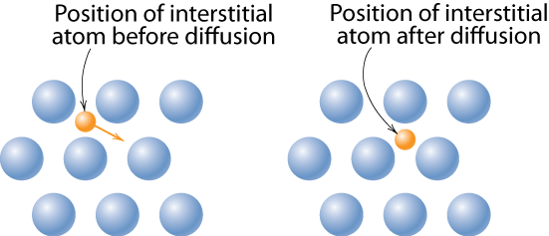
Diffusion Mechanisms
Interstitial diffusion – smaller atoms can diffuse between atoms.
Adapted from Fig. 5.3 (b), Callister 7e.
More rapid than vacancy diffusion
Notes:
this is essentially mechanism in amorphous materials such as polymer membranes

Slide 10

Processing Using Diffusion
• Case Hardening:
--Diffuse carbon atoms
into the host iron atoms
at the surface.
--Example of interstitial
diffusion is a case
hardened gear.
Adapted from chapter-opening photograph, Chapter 5, Callister 7e. (Courtesy of
Surface Division, Midland-Ross.)
• Result: The presence of C
atoms makes iron (steel) harder.

Slide 11
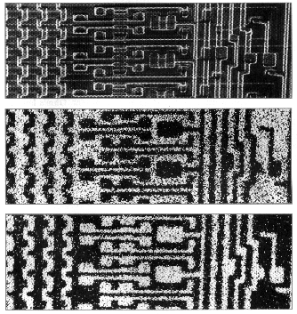
Processing Using Diffusion
• Doping silicon with phosphorus for n-type semiconductors:
• Process:
0.5 mm
1. Deposit P rich
layers on surface.
magnified image of a computer chip
silicon
2. Heat it.
3. Result: Doped
semiconductor
regions.
light regions: Si atoms
light regions: Al atoms
silicon
Adapted from chapter-opening photograph, Chapter 18, Callister 7e.

Slide 12
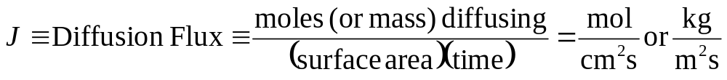
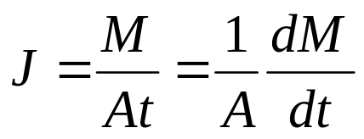
Diffusion
How do we quantify the amount or rate of diffusion?
Measured empirically
  Make thin film (membrane) of known surface area
  Impose concentration gradient
  Measure how fast atoms or molecules diffuse through the membrane
M =
mass
diffused
J ∝ slope
time

Slide 13
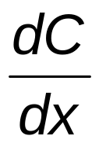
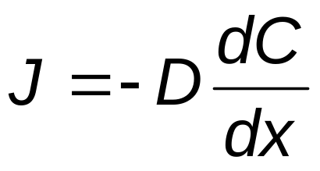
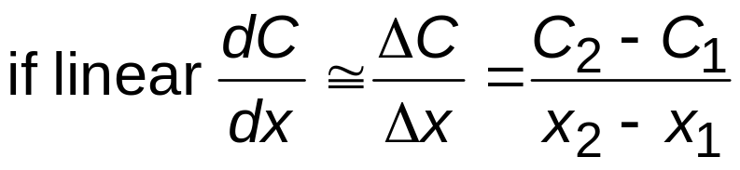
Steady-State Diffusion
Rate of diffusion independent of time
  Flux proportional to concentration gradient =
C₁
C₁
Fick’s first law of diffusion
C₂
C₂
x₁
x₂
x
D ≡ diffusion coefficient

Slide 14
Example: Chemical Protective Clothing (CPC)
Methylene chloride is a common ingredient of paint removers. Besides being an irritant, it also may be absorbed through skin. When using this paint remover, protective gloves should be worn.
If butyl rubber gloves (0.04 cm thick) are used, what is the diffusive flux of methylene chloride through the glove?
Data:
  diffusion coefficient in butyl rubber:
  D = 110 x10⁻⁸ cm²/s
  surface concentrations:
C₁ = 0.44 g/cm³
C₂ = 0.02 g/cm³

Slide 15
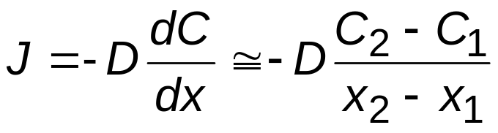

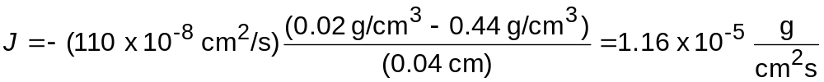
Example (cont).
Solution – assuming linear conc. gradient
glove
C₁
paint
remover
skin
Methylene chloride
C₂
Data:
D = 110 x 10⁻⁸ cm²/s
x₁
x₂
C₁ = 0.44 g/cm³
C₂ = 0.02 g/cm³
x₂ – x₁ = 0.04 cm
Note: For a skin to be affected,
50 ppm, 174 mg/m³
Must not exceed 125 ppm

Slide 16
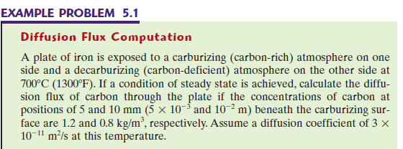
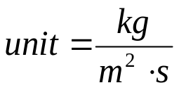
Example 5.1
D=3x10⁻¹¹ m²/s
C1=1.2kg/m³
C2=0.8kg/m³
X1=5mm
X2=10mm
C₁
C₁
C₂
C₂
x₁
x₂
x

Slide 17
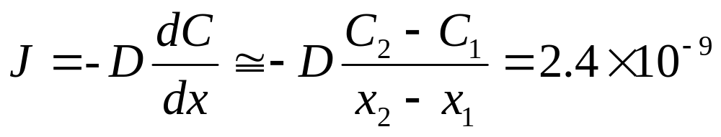
In Class Quiz
D=3x10⁻¹¹ m²/s
C1=1.2kg/m³
C2=0.8kg/m³
X1=5mm
X2=10mm
C₁
C₁
C₂
C₂
x₁
x₂
x
Use Matlab to solve the example

Slide 18
Diffusion and Temperature
D has exponential dependence on T
1500
1000
600
300
T(°C)
10⁻⁸
D (m²/s)
C in γ-Fe
D
>> D
C in α-Fe
interstitial
substitutional
C in α-Fe
Al in Al
10⁻¹⁴
Fe in α-Fe
C in γ-Fe
Fe in α-Fe
Fe in γ-Fe
Al in Al
Fe in γ-Fe
10⁻²⁰
0.5
1.0
1.5
1000 K/T
Adapted from Fig. 5.7, Callister 7e. (Date for Fig. 5.7 taken from E.A. Brandes and G.B. Brook (Ed.) Smithells Metals Reference Book, 7th ed., Butterworth-Heinemann, Oxford, 1992.)

Slide 19
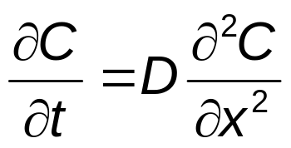
Non-steady State Diffusion
The concentration of diffucing species is a function of both time and position C = C(x,t)
In this case Fick’s Second Law is used
Fick’s Second Law
Note: Solutions to this expression (concentration in terms of both position and time) are possible when physically meaningful boundary conditions are specified
Notes:
In the non-steady state the concentration profile develops with time.

Slide 20
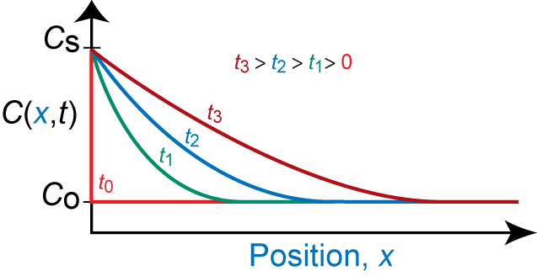
Non-steady State Diffusion
• Copper diffuses into a bar of aluminum.
Surface conc.,
C
of Cu atoms
bar
s
pre-existing conc., C_{o} of copper atoms
C
s
Adapted from Fig. 5.5, Callister 7e.
B.C. at t = 0, C = C_{o} for 0 ≤ x ≤ ∞
at t > 0, C = C_{S} for x = 0 (Cs surface concentration)
C = C_{o} for x = ∞

Slide 21
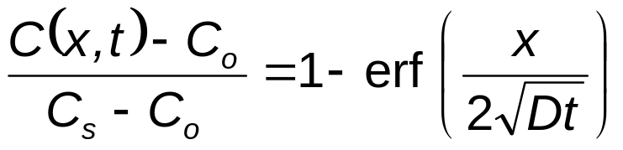
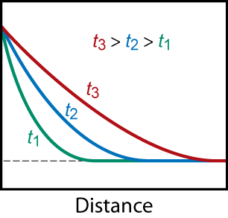
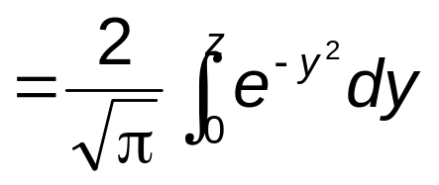
Solution:
C(x,t) = Conc. at point x at
time t
erf (z) = error function
erf(z) values are given in Table 5.1
C_{S}
C(x,t)
C_{o}

Slide 22
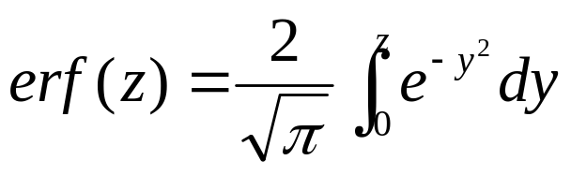
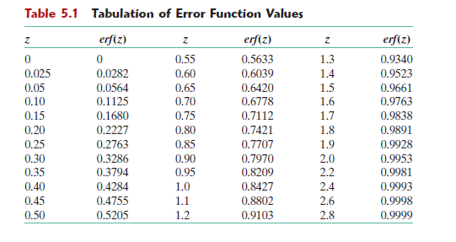

Slide 23
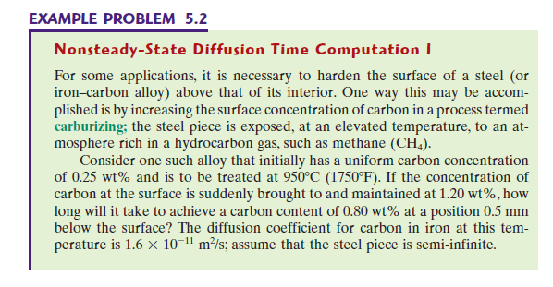
Co=?
Cs=?
D=?
t=?
X=?
C(x,t)=?

Slide 24
Side Note
Methane (CH₄) Cs=1.2%
Cx=.8%
0.5mm
Co=.25%
Steel
D=1.6x10⁻¹¹ m²/s
Temp=950⁰
How long does it take?

Slide 25
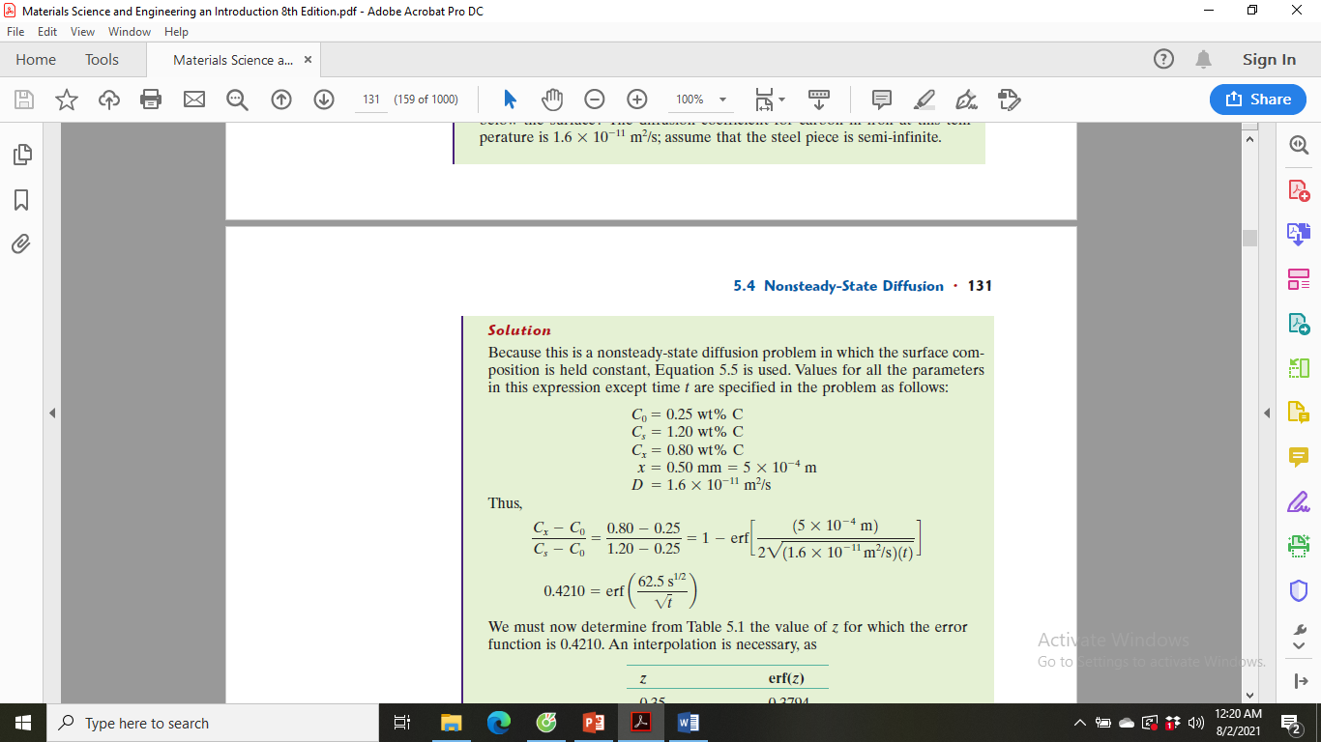
Solution
We must now determine from Table 5.1 the value of z for which the error function is 0.4210. Once we have z, we can find t.

Slide 26
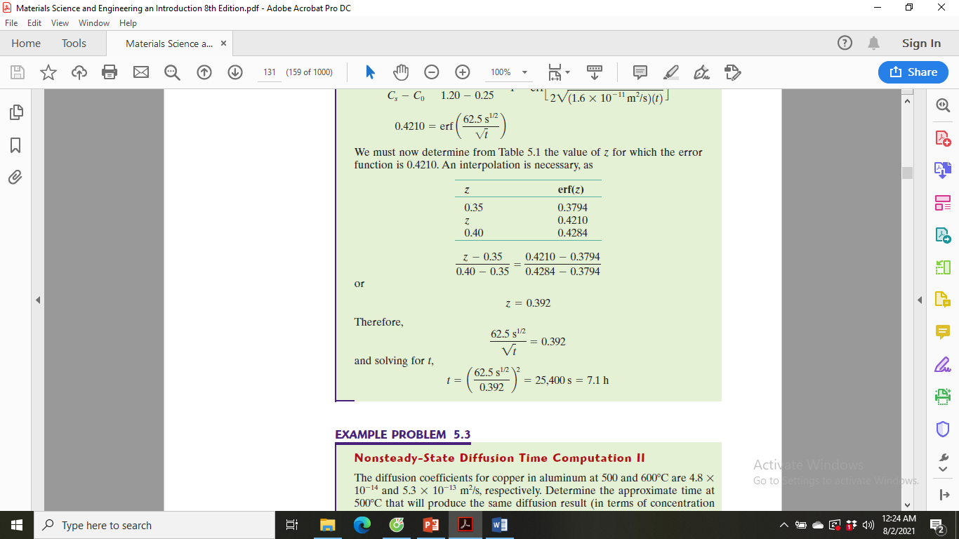

Slide 27
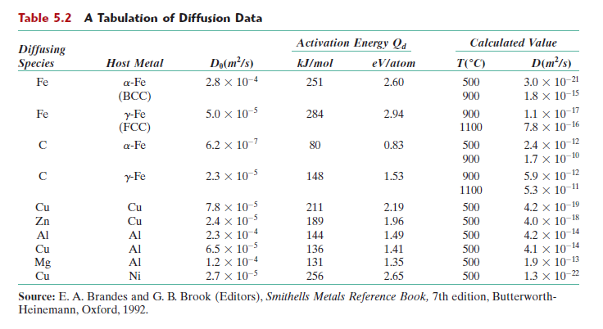
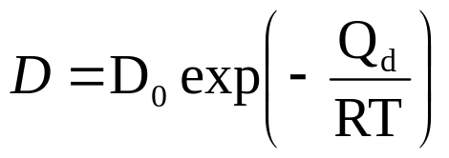
D is dependent on the Temperature by
R = the gas constant, 8.31 J/mol.K or 8.62 x10⁻⁵ eV/atom.K

Slide 28
MATLAB QUIZ
Use matlab to sovle example 5.2
Set the parameters
Note: D is given
To calculate D
Use table 5.2
Calculate left side
Use command erfinv to find z
Solve for t

Slide 29
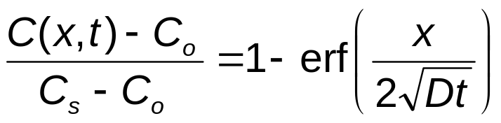
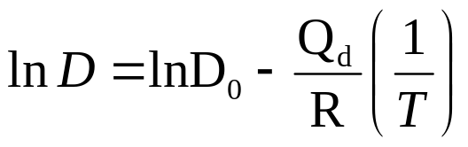
Non-steady State Diffusion
Sample Problem: An FCC iron-carbon alloy initially containing 0.20 wt% C is carburized at an elevated temperature and in an atmosphere that gives a surface carbon concentration constant at 1.0 wt%. If after 49.5 h the concentration of carbon is 0.35 wt% at a position 4.0 mm below the surface, determine the temperature at which the treatment was carried out.
Solution:

Slide 30
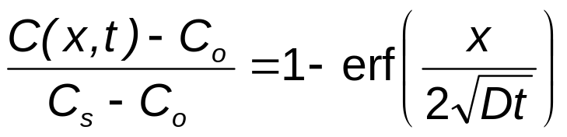
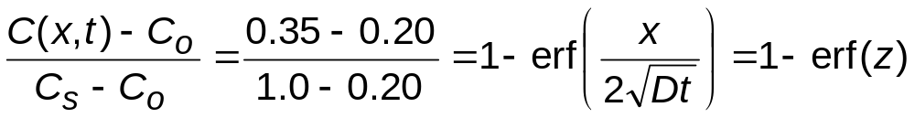
Solution (cont.):
  t = 49.5 h x = 4 x 10⁻³ m
  C_{x} = 0.35 wt% C_{s} = 1.0 wt%
  C_{o} = 0.20 wt%
∴ erf(z) = 0.8125

Slide 31
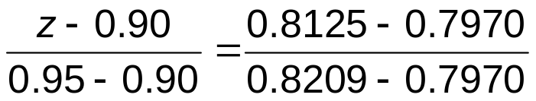
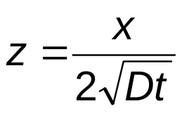
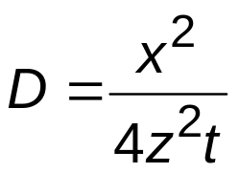
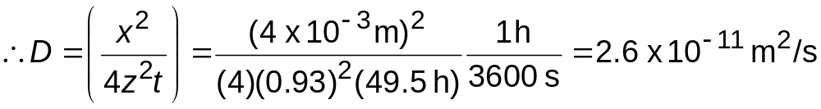
Solution (cont.):
We must now determine from Table 5.1 the value of z for which the error function is 0.8125. An interpolation is necessary as follows
z
erf(z)
0.90 0.7970
z 0.8125
0.95 0.8209
z = 0.93
Now solve for D

Slide 32
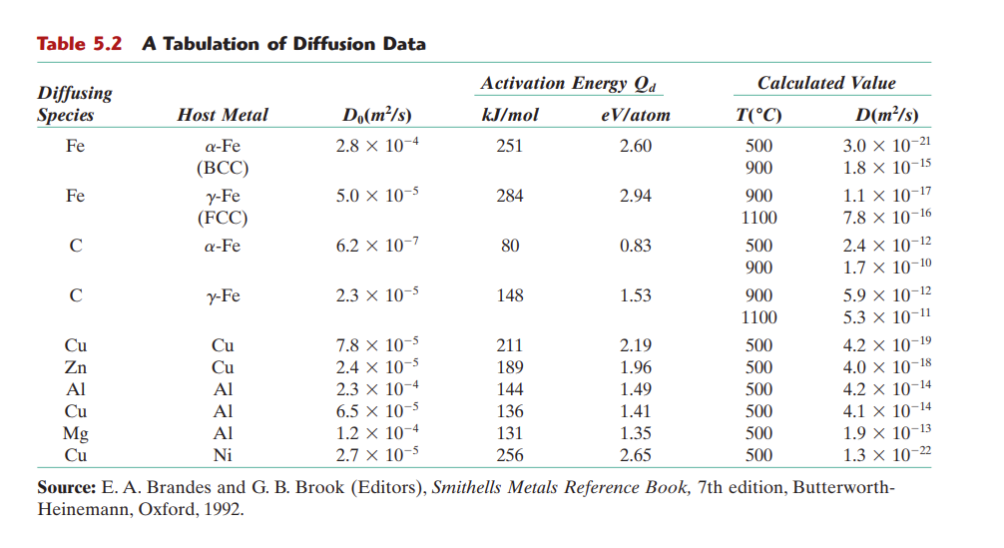

Slide 33
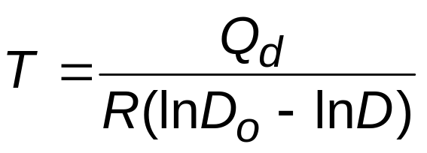
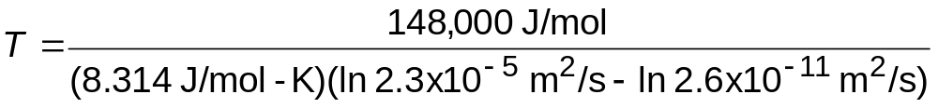
Solution (cont.):
To solve for the temperature at which D has above value, we use a rearranged form of Equation (5.9a);
from Table 5.2, for diffusion of C in FCC Fe
D_{o} = 2.3 x 10⁻⁵ m²/s Q_{d} = 148,000 J/mol
∴
T = 1300 K = 1027°C
You have to be able to perform this problem with matlab

Slide 34
Summary
Diffusion FASTER for...
• open crystal structures
• materials w/secondary
bonding
• smaller diffusing atoms
• lower density materials
Diffusion SLOWER for...
• close-packed structures
• materials w/covalent
bonding
• larger diffusing atoms
• higher density materials

Slide 35
HW
Read Chapter 5
HW
5.6
5.7
5.11 (use matlab to solve)
Note: D is not given and has to be calculated from table 5.2
5.17
5.18
5.31 (use matlab to solve, plot temperature for 2-8mm below)
Self-help Problems:

